Slide 1
STUDENT DATABASE MANAGEMENT SYSTEM
Application for storing and managing the record of large no of students in order
Notes:
Student Database Management System , as the name suggests, it will help you in managing the record of students effectively for various purposes . It will accept the correct data and will provide you with the correct output without any delay.

Slide 2
THE PROBLEM
We all are aware of the ongoing pandemic , many schools and colleges are shifting to online platforms for studies and keeping the record of the students , which has became quite hard to manage because of a large no of students.
Many teachers and students are also not families with the various technologies and platform for maintaining and storing the data safely . Due to this they waste a lot of time in learning and interacting with those complicated interfaces.
Notes:
As in today's time many universities and schools are using online platform to studies and keeping the record of system because of the ongoing CORONA pandemic , so it has become hard to keep the record of a large no of students and manage that properly.
Many teachers and faculty members are not used to the various online technologies and find it hard to interact with them .
This results in wastage of time because they have to learn those interfaces to interact with them .

Slide 3
What is the more effective solution ?
Notes:
So if those are the problems then here comes the most obvious question that , WHAT IS THE MORE EFFECTIVE SOLUTION FOR IT THEN ?

Slide 4
Well here is the solution for it .
Notes:
Well, I am very glad to present you with the solution .

Slide 5
STOCKPILE
Key Features
Adding the record of Students
Displaying Data of Students
Searching the record
Modifying record
Deleting record
Sorting the record
Notes:
StockPile , an easy , fast and effective program to maintain and organize data .
Its key features are as follow
We can add new record of student
Display the record stored in file
Search for the desired record
Modify the record which we want
Deleting an existing record
And Sorting the record of the file

Slide 6
STOCKPILE
Fast and Secure
Stores the data in file
Friendly Interface
It shows the result very fast and takes valid data only from the user.
It is very easy to interact with the program
It stores the data entered by the user in a file .
Notes:
What are the advantages of StockPile
Advantages of StockPile over other platforms are
Its interface is very userfriendly and very interactive
It stores the data entered by user in a file for further use
Its very fast and very precise with its result ,as it only takes valid information from the user.

Slide 7
WORKING OF THE PROGRAM
Notes:
Now let me show the working of the Project

Slide 8
ADDING THE STUDENT DATA
User enters Student data
Reads the data from user and check for validation
If correct validation
If not valid
Writes the data in file
Closes file
Notes:
For adding the Student data
Firstly it will open the a file in append mode
Then it will ask the data from the user and check if its valid or not
If its valid then it writes the data in file
Else if its not valid then it asks again to enter correct data from user
After writing the data in file , it closes the file.

Slide 9
DISPLAYING THE RECORD
Opens the file in which record are stored for reading
Reads record one by one
Displays record on screen
Closes the file after no record is left
Notes:
For displaying the data
It will open the file in reading mode
Then it will read the record one by one until the end of file
As reading the record one by one it will simultaneously display the record on screen
When the file pointer reaches the end of file it will close the file and we will get our record displayed.

Slide 10
SEARCHING FOR RECORD
Opens the file in which record are stored for reading
Asks the user , the record to find for
Searches for record
Print record not found
If record not found
Closes the file
Display the record found
If found the record
Notes:
Next functionality is searching record
For reaching a record in file
It will open the main file in reading mode
Then it will ask the user to enter the record to search for
After that it will go through the file and it will search for record
If it founds the record then it will print that on the screen
If the record is not present in file then it will print record not found message
After that it will close the file

Slide 11
MODIFYING THE RECORD
Opens the file in which data is stored for reading and writing
Asks the user to enter record to modify
Searches for the record in file
If record not found , print record not found
If record is found , ask user to enter new data
Write the new data in file
Closes the file
Notes:
For modifying the record
It will open the file in reading and writing mode
Then it will ask the user which record to modify
After that it will search for that record in the file
If the record Is found , it will ask for the new data to store
After getting the new data , it will write that data in place of old data
If the record is not found , it will print the record not found message on screen
Lastly it will close the file

Slide 12
DELETING THE RECORD
Opening the file in which data is stored for reading
Asks the user to enter the record to delete
Copy all the data except the data to delete in new file
Delete old file and rename the new file as of old file
Close the file
Notes:
For deletion of record
It will open the main file in reading mode , also it will open a new file in append mode
Then it will ask for the record from the user to delete
So now it will copy all the record from the main file to the new file except the record which we want to delete
After that it will delete the main file and name the new file as of the main file
Close the file then .

Slide 13
SORTING THE RECORD
Opens the file of record to read records
Count the no of records and store them in an array of records
Sort the data stored in the array using selection sort
Close the file
After sorting, display the record on screen
Notes:
For sorting the result ,
Open the file in read mode
Count the no of records from file
Then create an array of record
then store the record in the array of records
Then it sort the data of that array using selection sort
After the data is sorted then display the data on screen
At last close the file .

Slide 14
DEMO
Notes:
Now here are some demo views of how it looks and how it interacts

Slide 15
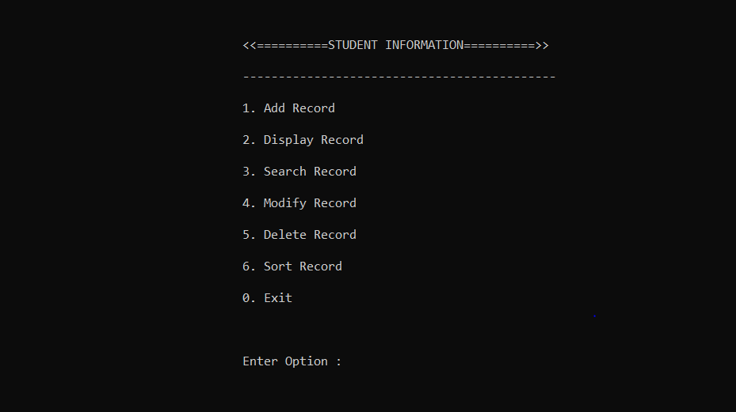
MAIN MENU INTERFACE
Notes:
This is the main menu of the program
It shows all the options

Slide 16
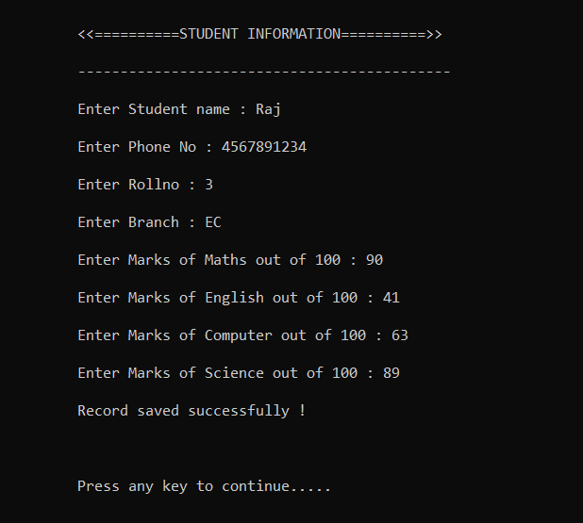
ADD RECORD
Notes:
It’s the interface when we want to add a new record ,
It will ask for data such as name, phone no , rollno, branch, marks in subject for calculating the result

Slide 17
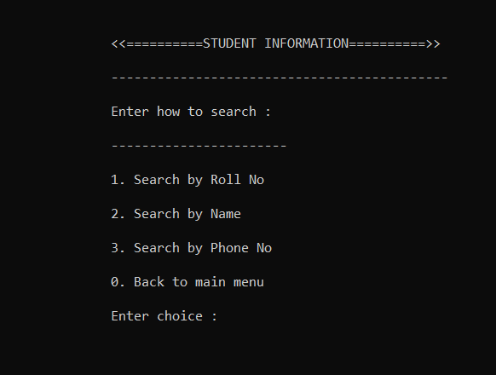
SEARCH RECORD
Notes:
Its our search interface
It will ask how to search for record

Slide 18
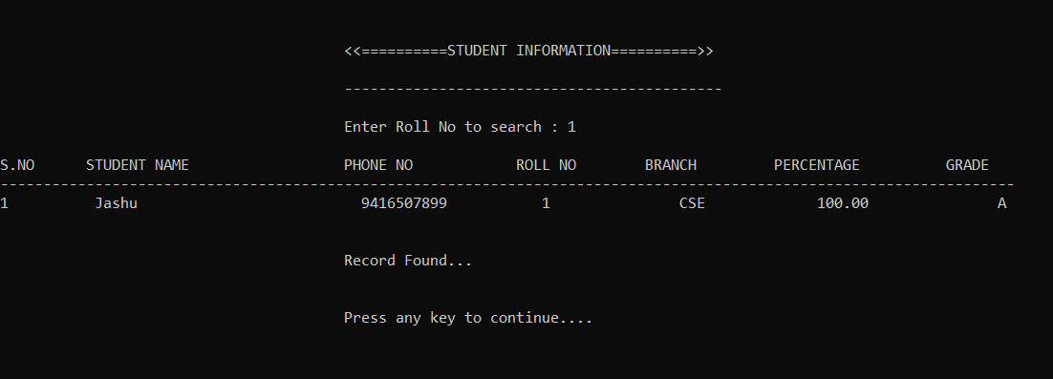
SEARCH RECORD
Notes:
This is the result of searching

Slide 19
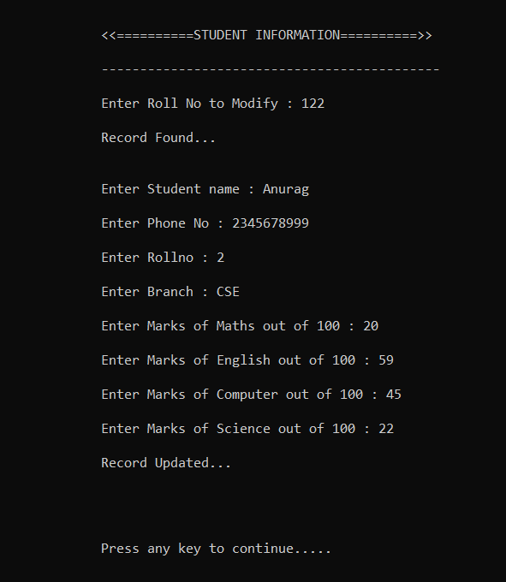
MODIFY RECORD
Notes:
Its our modify interface

Slide 20
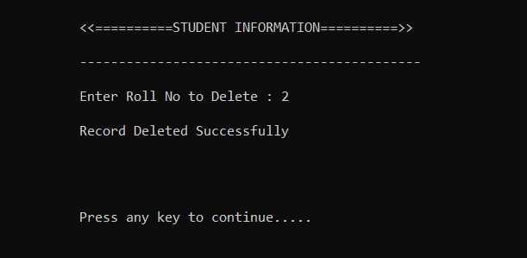
DELETE RECORD
Notes:
Its how the delete function works

Slide 21
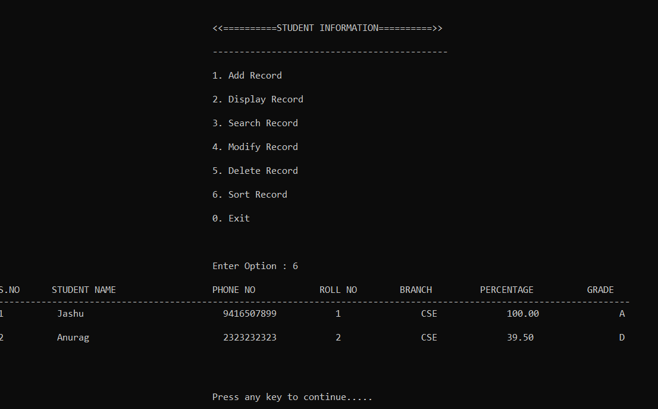
SORT RECORD
Notes:
And its what our sorting interface looks like .

Slide 22
THANK YOU
Notes:
At last thank you sir for your guidance and for your help in providing us with so many new things to learn and practice.

